Slide 1
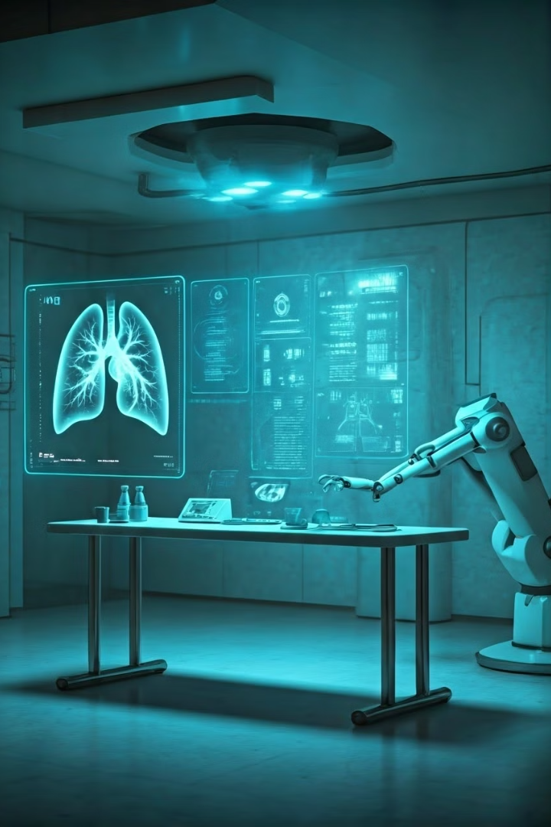
Advanced COVID-19 Detection from Lung X-rays with Machine Learning or Deep Learning
NAME:DINESHKARAN M,
E-MAIL: bobbyyt16@gmail.com
NM ID: au912721114003
COLLEGE: St. Michael college of Engg & Tech Kalayarkoil

Slide 2
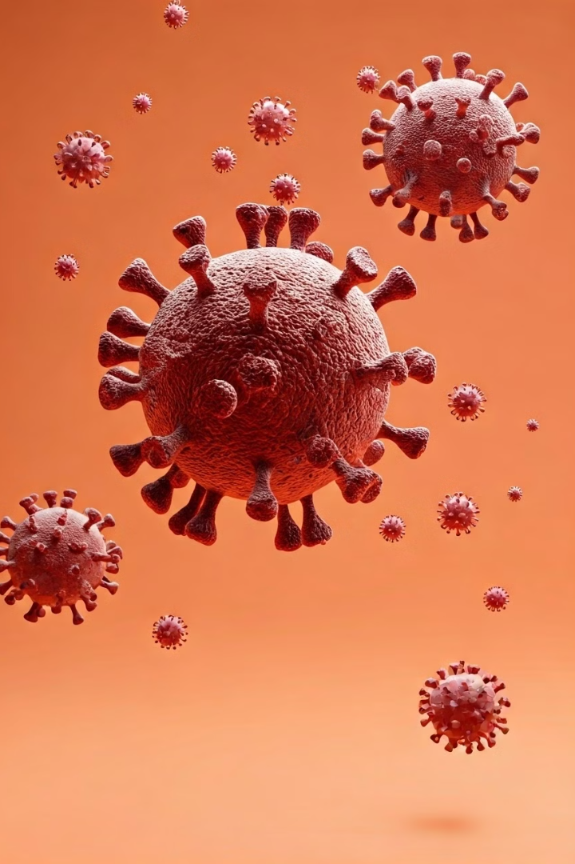
Introduction to COVID-19 and the Need for Rapid Diagnosis
1
Global Pandemic
COVID-19 emerged in late 2019, quickly spreading worldwide. It poses significant health challenges and strains healthcare systems globally.
2
Symptoms and Transmission
The virus spreads through respiratory droplets, causing various symptoms. Early detection is crucial for effective treatment and containment.
3
Rapid Diagnosis Imperative
Swift, accurate diagnosis is essential for patient care and pandemic control. It enables timely treatment and helps prevent further spread.

Slide 3

Overview of Traditional COVID-19 Detection Methods
RT-PCR Tests
Antigen Tests
Antibody Tests
Gold standard for COVID-19 detection. Highly accurate but time-consuming and requires specialized equipment.
Rapid tests detecting viral proteins. Quicker results but less sensitive than RT-PCR.
Detect past infections by identifying antibodies. Not suitable for early diagnosis.

Slide 4
Limitations of Traditional Methods and the Role of Imaging
Traditional Method Limitations
Imaging Advantages
AI-Enhanced Imaging
X-rays provide rapid results and visualize lung involvement. They offer a complementary diagnostic tool to traditional methods.
Machine learning algorithms can analyze X-rays quickly and accurately. This approach augments radiologists' expertise and speeds up diagnosis.
Time-consuming processes and potential false negatives. Supply shortages and high costs limit widespread testing.

Slide 5
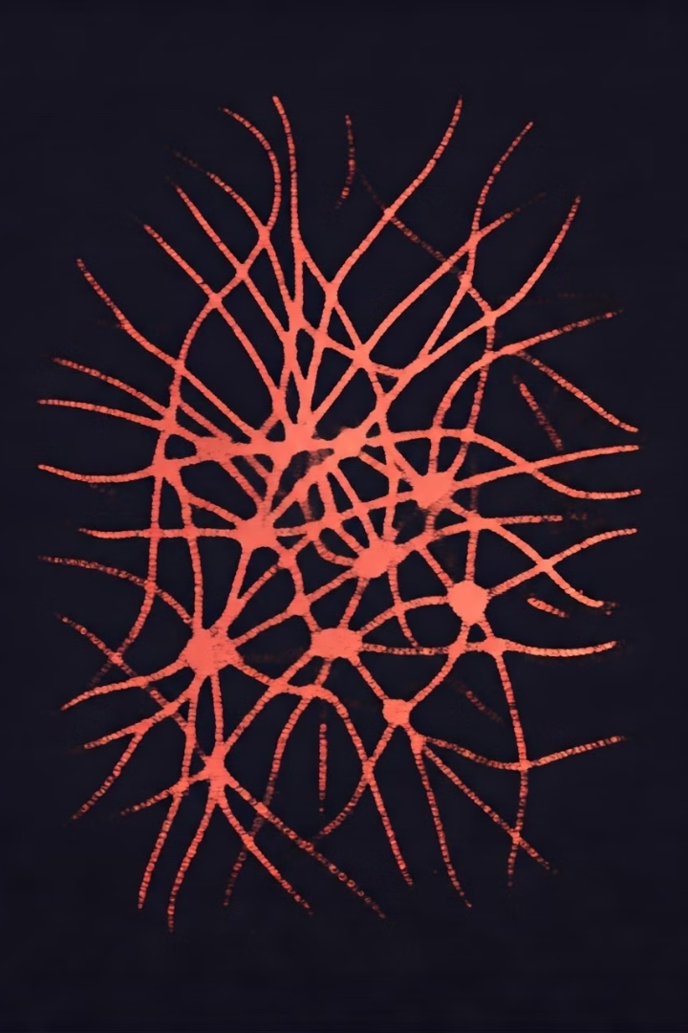
Fundamentals of Machine Learning and Deep Learning
1
Machine Learning Basics
2
Deep Learning Specialization
Algorithms learn patterns from data without explicit programming. They improve performance through experience and data exposure.
A subset of machine learning using multi-layered neural networks. It excels at complex pattern recognition in large datasets.
3
Supervised Learning for Classification
Models learn from labeled data to classify new, unseen examples. This approach is crucial for COVID-19 detection from X-rays.

Slide 6
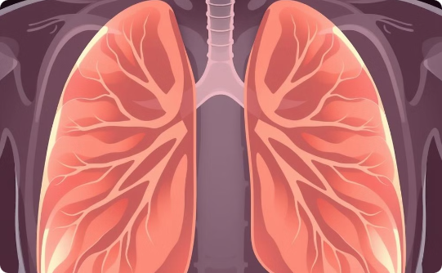
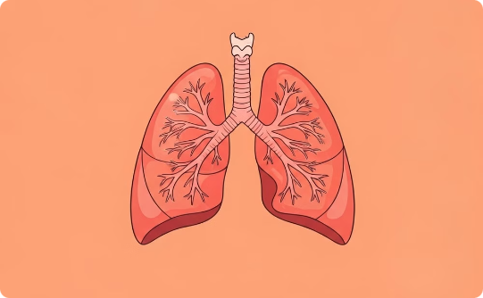
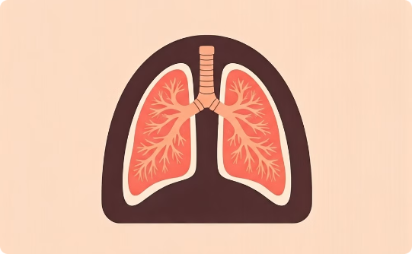
Leveraging Lung X-rays for COVID-19 Detection
Normal Lung X-ray
COVID-19 Infected Lung
AI-Enhanced Analysis
Healthy lungs show clear lung fields without opacities or consolidations.
COVID-19 often presents as bilateral ground-glass opacities and consolidations in X-rays.
AI algorithms can detect subtle changes and patterns invisible to the human eye.

Slide 7
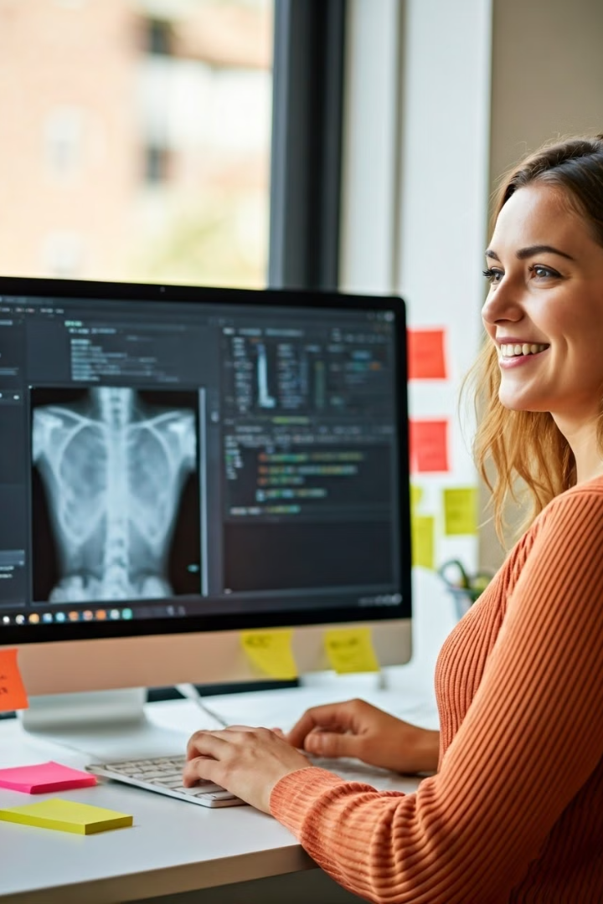



Data Preprocessing and Feature Engineering
Image Collection
Gathering diverse X-ray images from various sources. Ensuring a balanced dataset of COVID-19 positive and negative cases.
Preprocessing
Standardizing image size, contrast enhancement, and noise reduction. Augmenting data through rotations, flips, and adjustments.
Feature Extraction
Identifying relevant features like texture patterns and lung segmentation. Enhancing model performance through domain-specific knowledge.

Slide 8





Convolutional Neural Networks (CNNs) for Image Classification
Convolutional Layers
Pooling Layers
Fully Connected Layers
Training Process
Extract features from input images. Detect edges, textures, and patterns in X-rays.
Reduce spatial dimensions of features. Enhance computational efficiency and feature invariance.
Combine extracted features for final classification. Determine the probability of COVID-19 presence.
Fine-tune model parameters using backpropagation. Optimize performance on training data.

Slide 9

Evaluation Metrics and Model Performance
Metric
Description
Importance
Accuracy
Overall correct predictions
General performance indicator
Sensitivity
True positive rate
Critical for minimizing missed cases
Specificity
True negative rate
Reduces false alarms
F1 Score
Harmonic mean of precision and recall
Balanced measure for imbalanced datasets

Slide 10

Challenges and Future Directions
1
Data Availability and Quality
2
Model Interpretability
Developing explainable AI models for medical professionals. Enhancing trust and adoption in clinical settings.
Ensuring diverse, high-quality datasets for model training. Addressing privacy concerns and data sharing limitations.
3
Integration with Clinical Workflows
4
Continuous Learning and Adaptation
Seamlessly incorporating AI tools into existing healthcare systems. Balancing automation with human expertise.
Creating models that evolve with new virus variants. Implementing federated learning for collaborative improvement.

Slide 11
CONCLUSION:
Summarizing The Transformative Potential of MACHINE LEARNING and X-Ray scans in revolutionizing COVID -19 detection
Emphasizing the need for collaborative efforts to harness the power of advanced technologies in combating
the global pandemic.

Slide 12
THANK YOU

